Slide 1
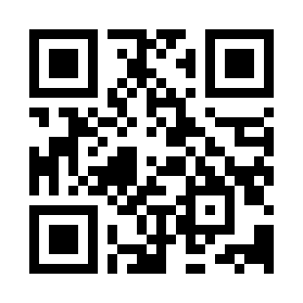
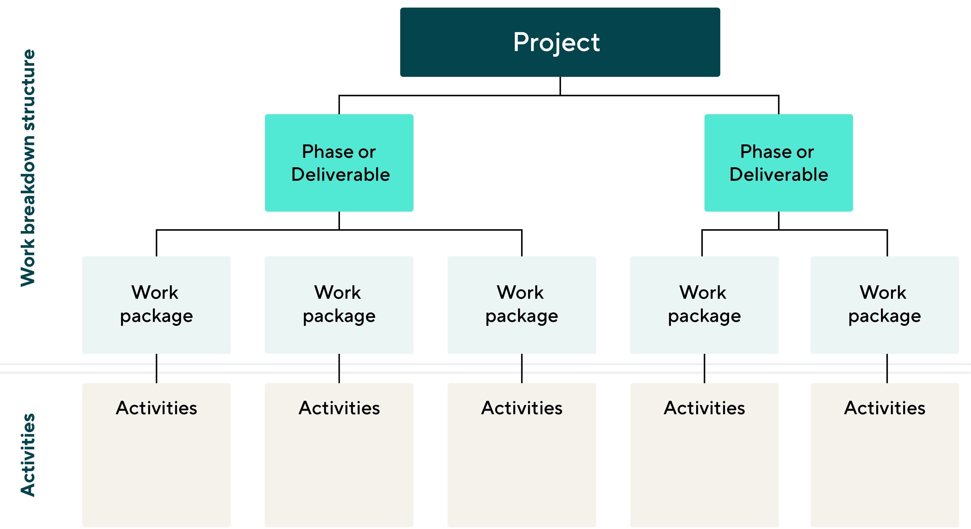
Work Breakdown Structure Quiz
https://bit.ly/3jBR9ma

